Slide 1

Learning Curve Analysis
Robotic Gastric Bypass
When does the surgeon become “safe”?
dr. miguel g. angeriz
Istituto nazionale per la cura dell’obesità
MILANO

Slide 2
THE CLINICAL QUESTION
What do we actually mean by “learning curve”?
Most learning-curve studies answer one question:
“When does the surgeon become faster?”
EFFICIENCY
PROFICIENCY
SAFETY
operative time
stable performance
clinical outcomes
But speed is only one dimension.
Our hypothesis
These three transitions may occur at different points - therefore there may be no single “safe case number”.
Faster ≠ proficient ≠ safe.
2

Slide 3
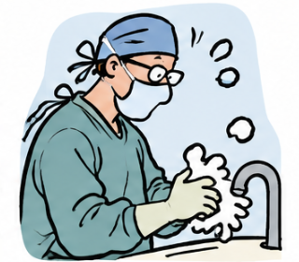
The surgeon does not start at case zero
1
Laparoscopic
Bariatric technique already established
2
Robotic SG
Platform familiarity is acquired
3
Robotic RYGB
A new procedure-specific challenge appears
Transfer of skill can shorten a learning curve - but cannot eliminate procedure-specific learning.
3

Slide 4
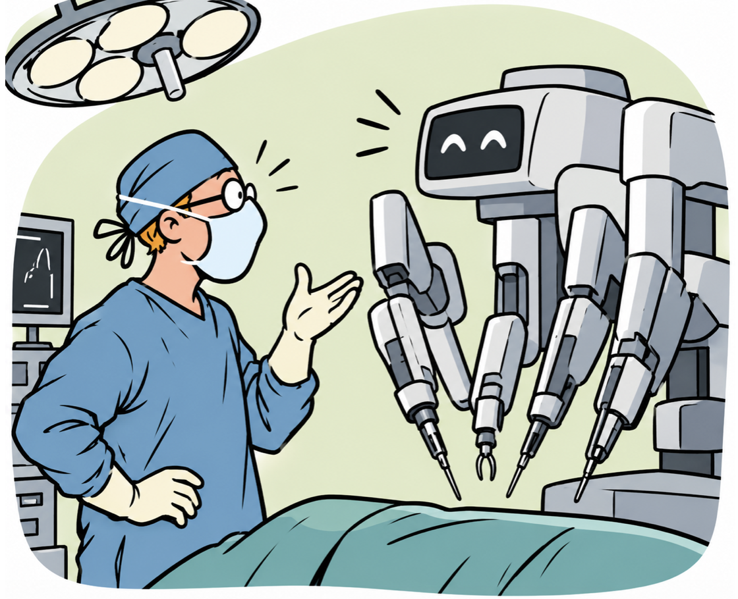
STUDY DESIGN
A real-world robotic RYGB series
37
15
0
0
robotic RYGB
revisional
conversions
intra-op complications
ANALYSIS
SAFETY
• Console time: primary efficiency endpoint
• Total operative time: secondary efficiency endpoint
• Case sequence analysed continuously
• Change-point + CUSUM
Clinically relevant events included leak, mechanical/anastomotic complications, transfusion and reoperation.
Timing and safety were analysed separately: a faster operation was not automatically considered a safer operation.
4

Slide 5
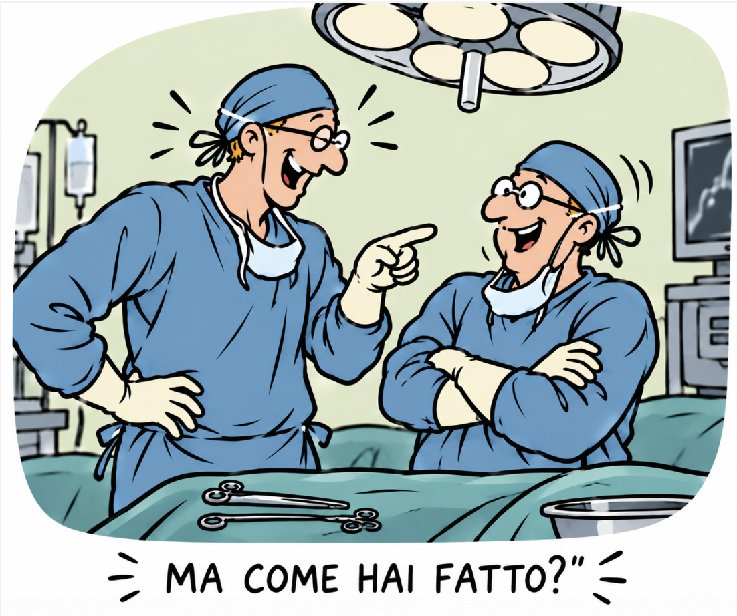
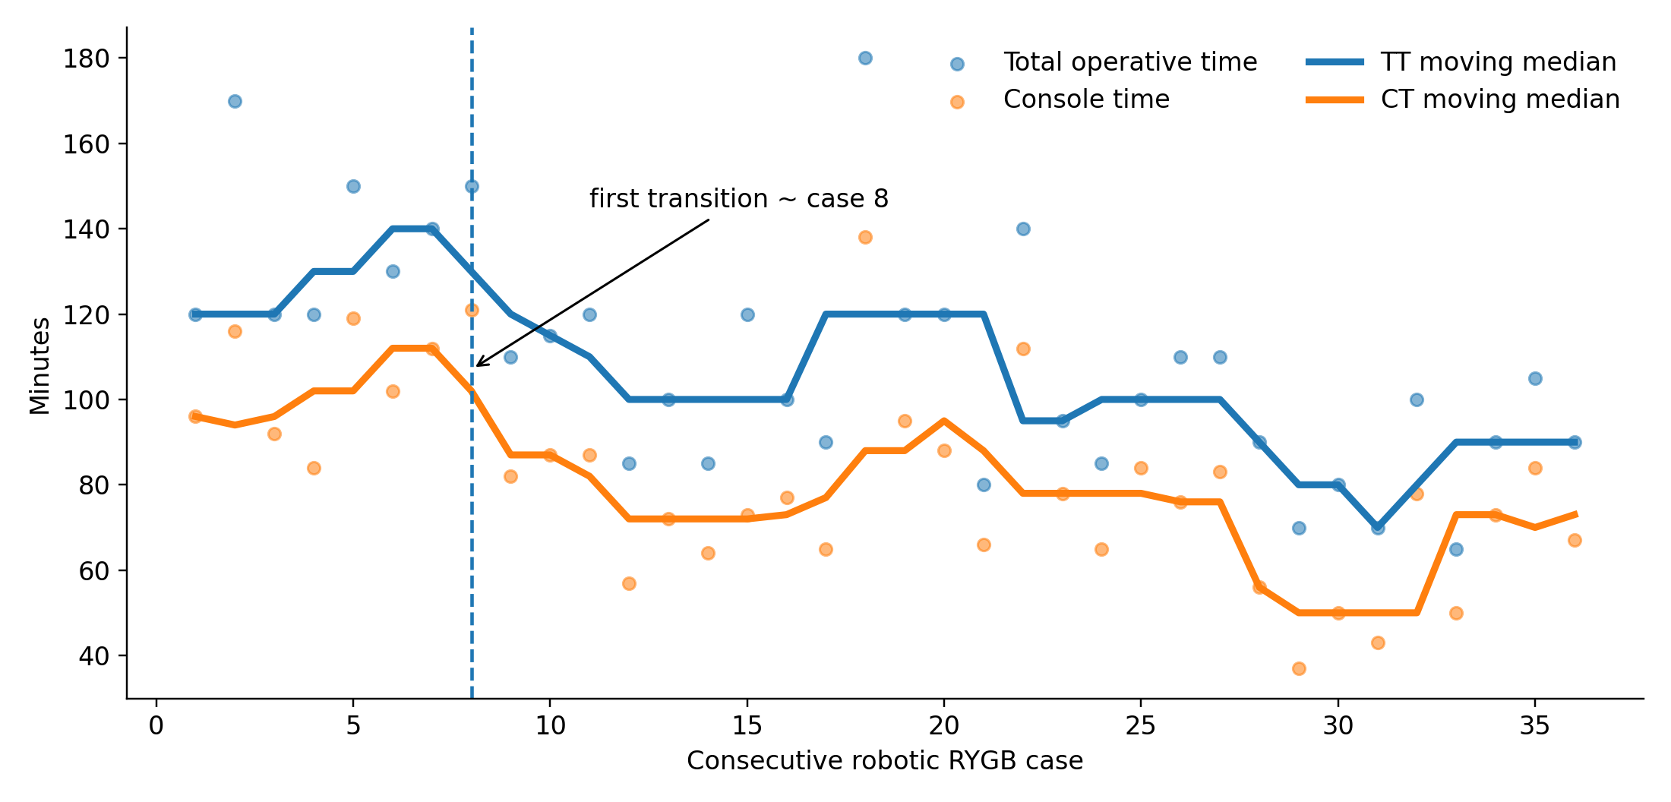
EFFICIENCY
The first major improvement occurs early
First major shift around case 8.
Median TT: 135 → 100 min
Median CT: 107 → 74.5 min
Interpretation: basic robotic RYGB efficiency is acquired surprisingly early.
5

Slide 6

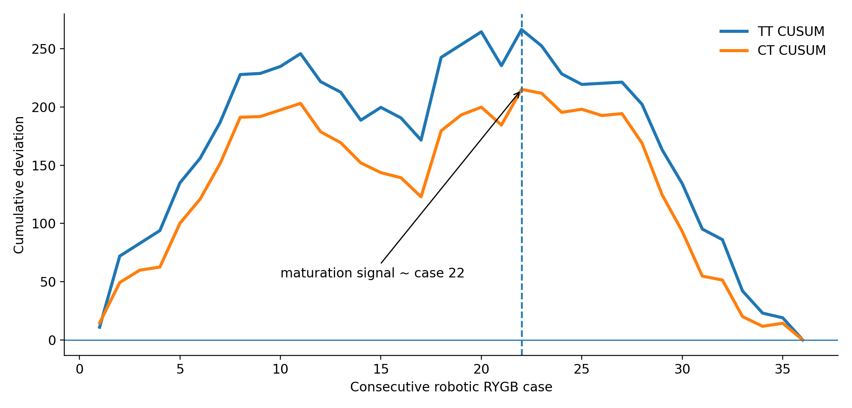
PROFICIENCY
But early improvement is not the same as full maturation
CUSUM accumulates the deviation of each case from the overall mean.
As long as cases remain slower than average, the curve rises. When performance consistently improves, it turns downward.
In our series, that maturation signal appears around case 22.
CT also falls progressively with experience.
Case 8 marks a first efficiency gain; ~22 cases better reflects sustained proficiency.
6

Slide 7

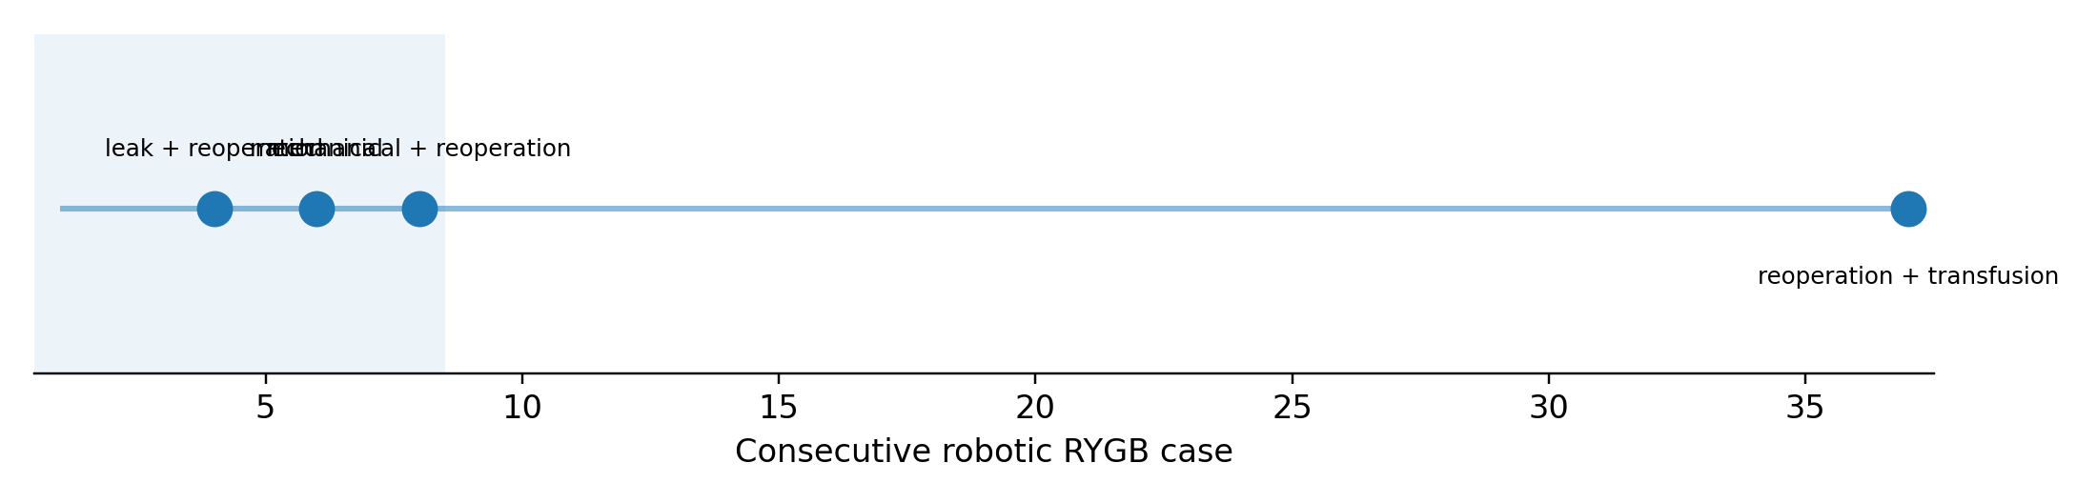
SAFETY
Complications follow yet another trajectory
Three relevant events occurred within the first 8 cases:
Only one further relevant event occurred in the following 29 cases: a late hemoperitoneum in a revisional case.
leak requiring reoperation
two GJ anastomotic stenoses
3/8 vs 1/29 • Fisher p = 0.026
Safety improves early, but the late event shows why safety cannot be reduced to a single threshold.
7

Slide 8
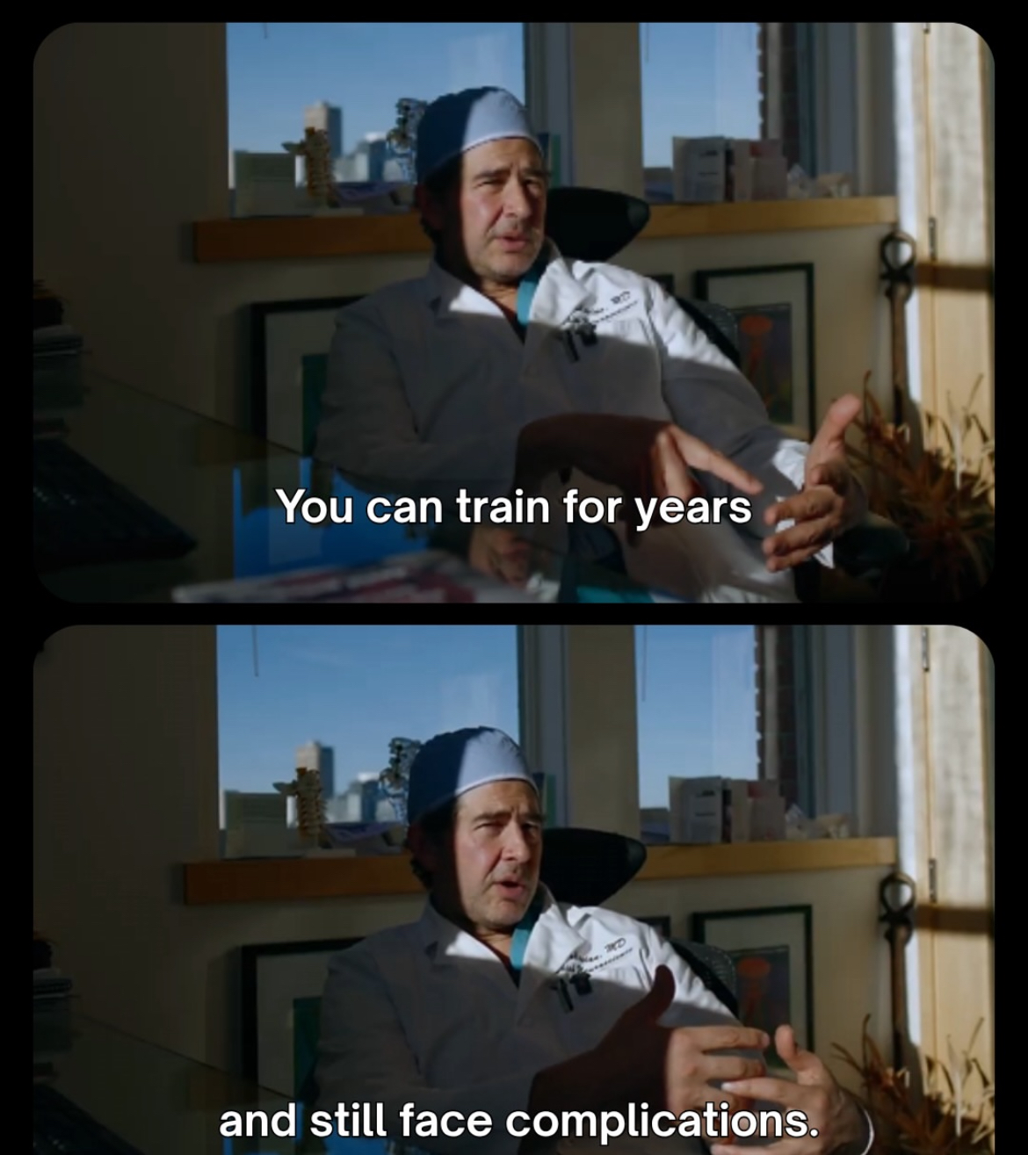
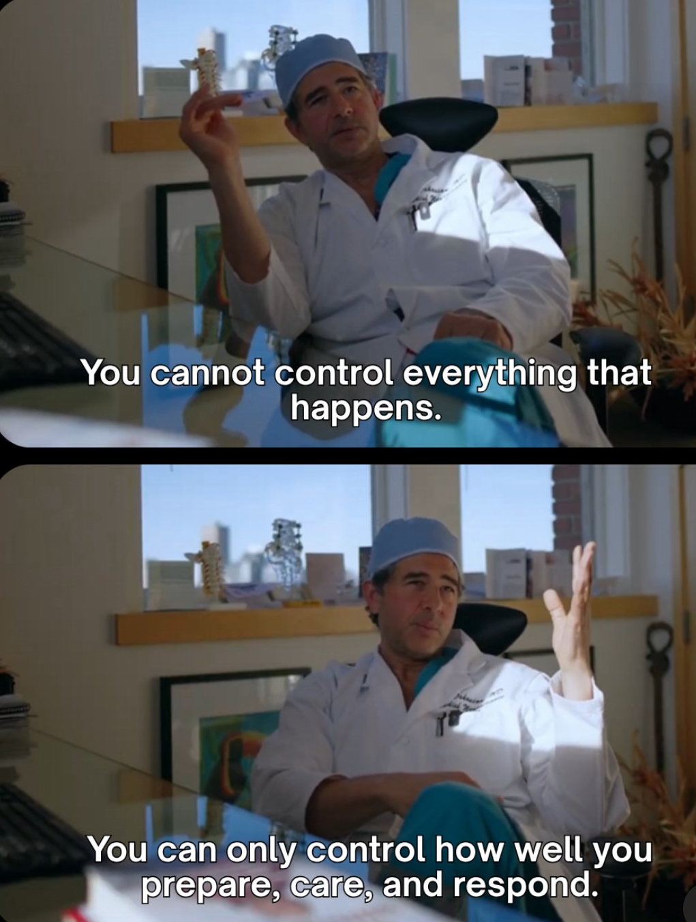
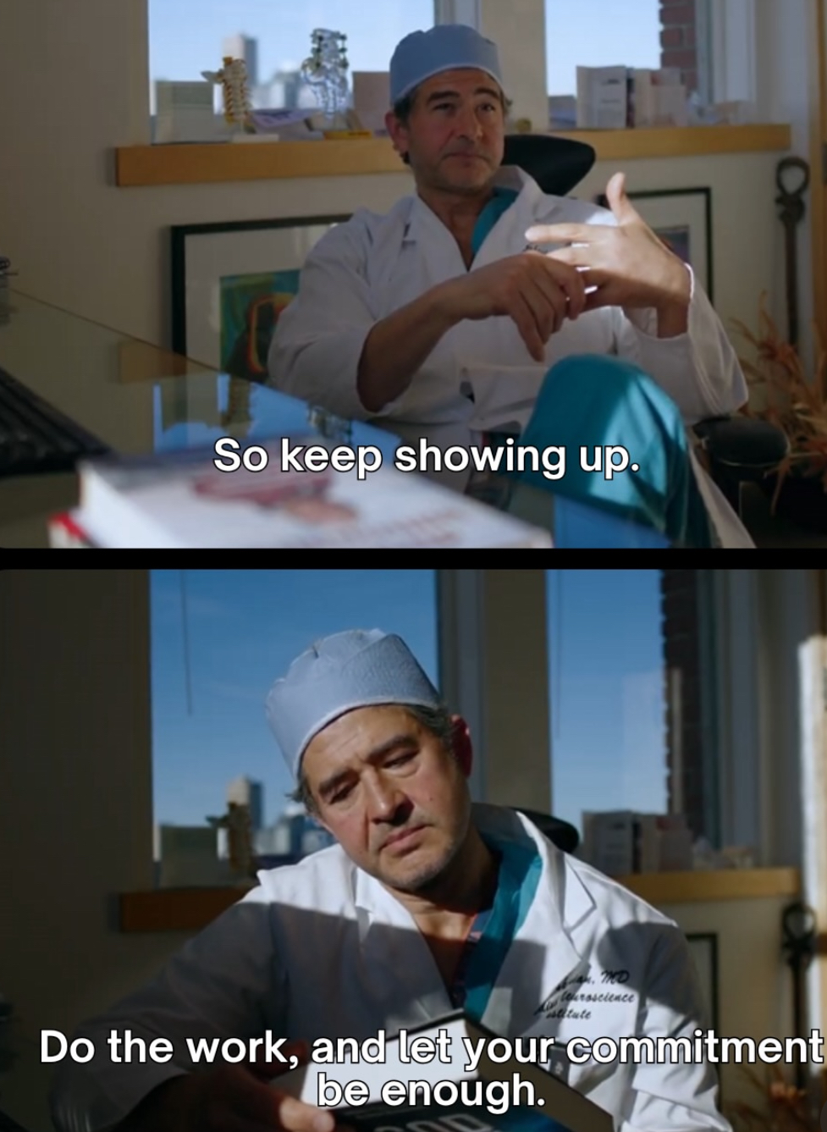
ANSWER
So, when does the surgeon become “safe”?
~8
~22
NO MAGIC NUMBER
first major
efficiency gain
sustained performance
maturation
clinical safety
9

Slide 9
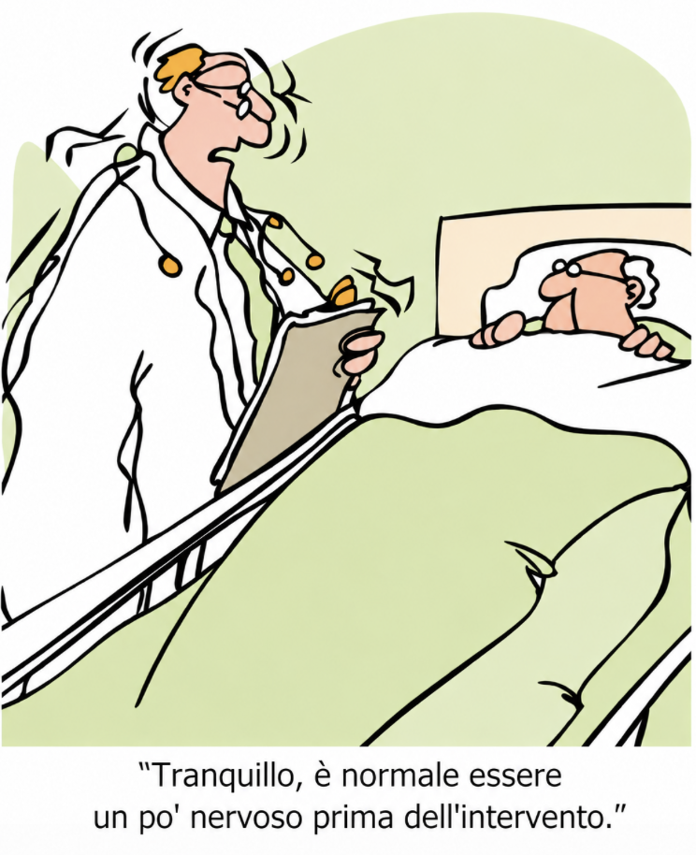
Gracias!

